Slide 1
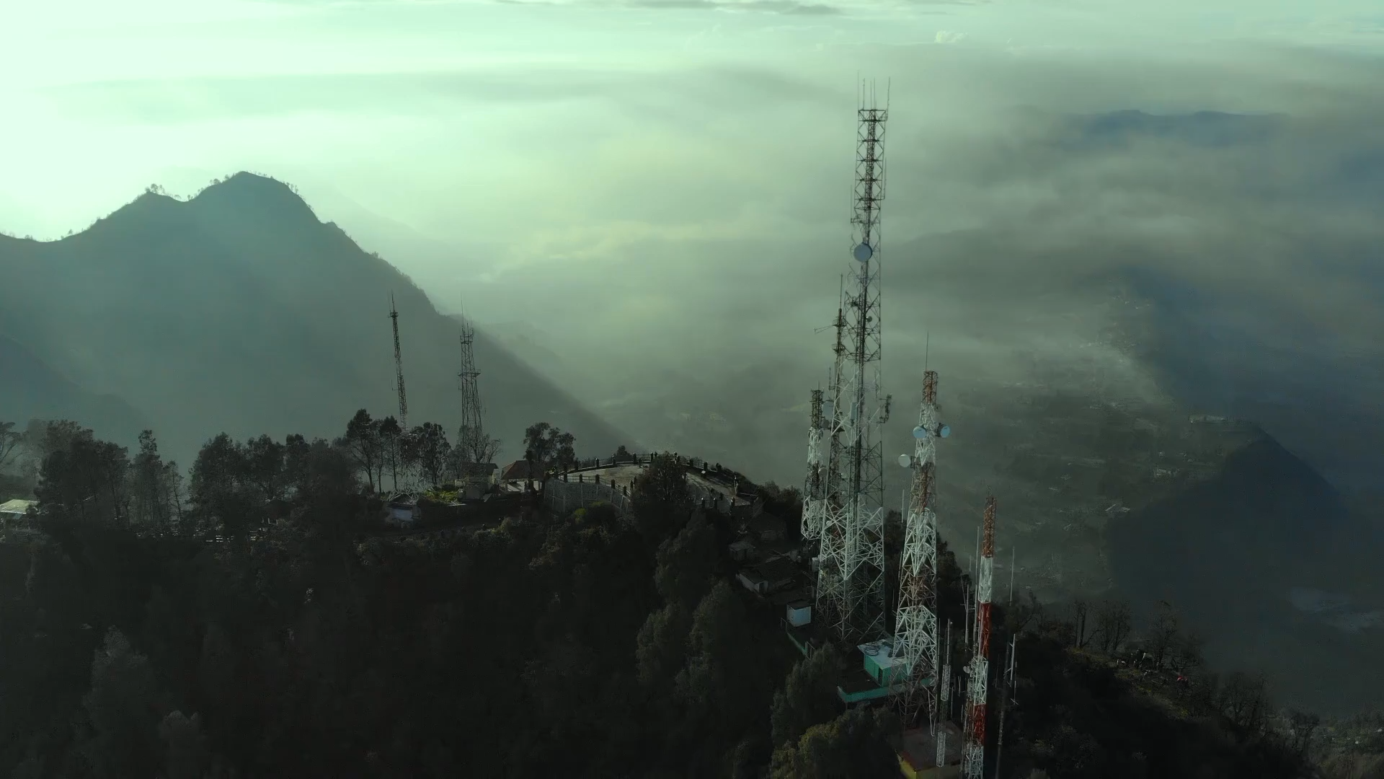


Slide 2
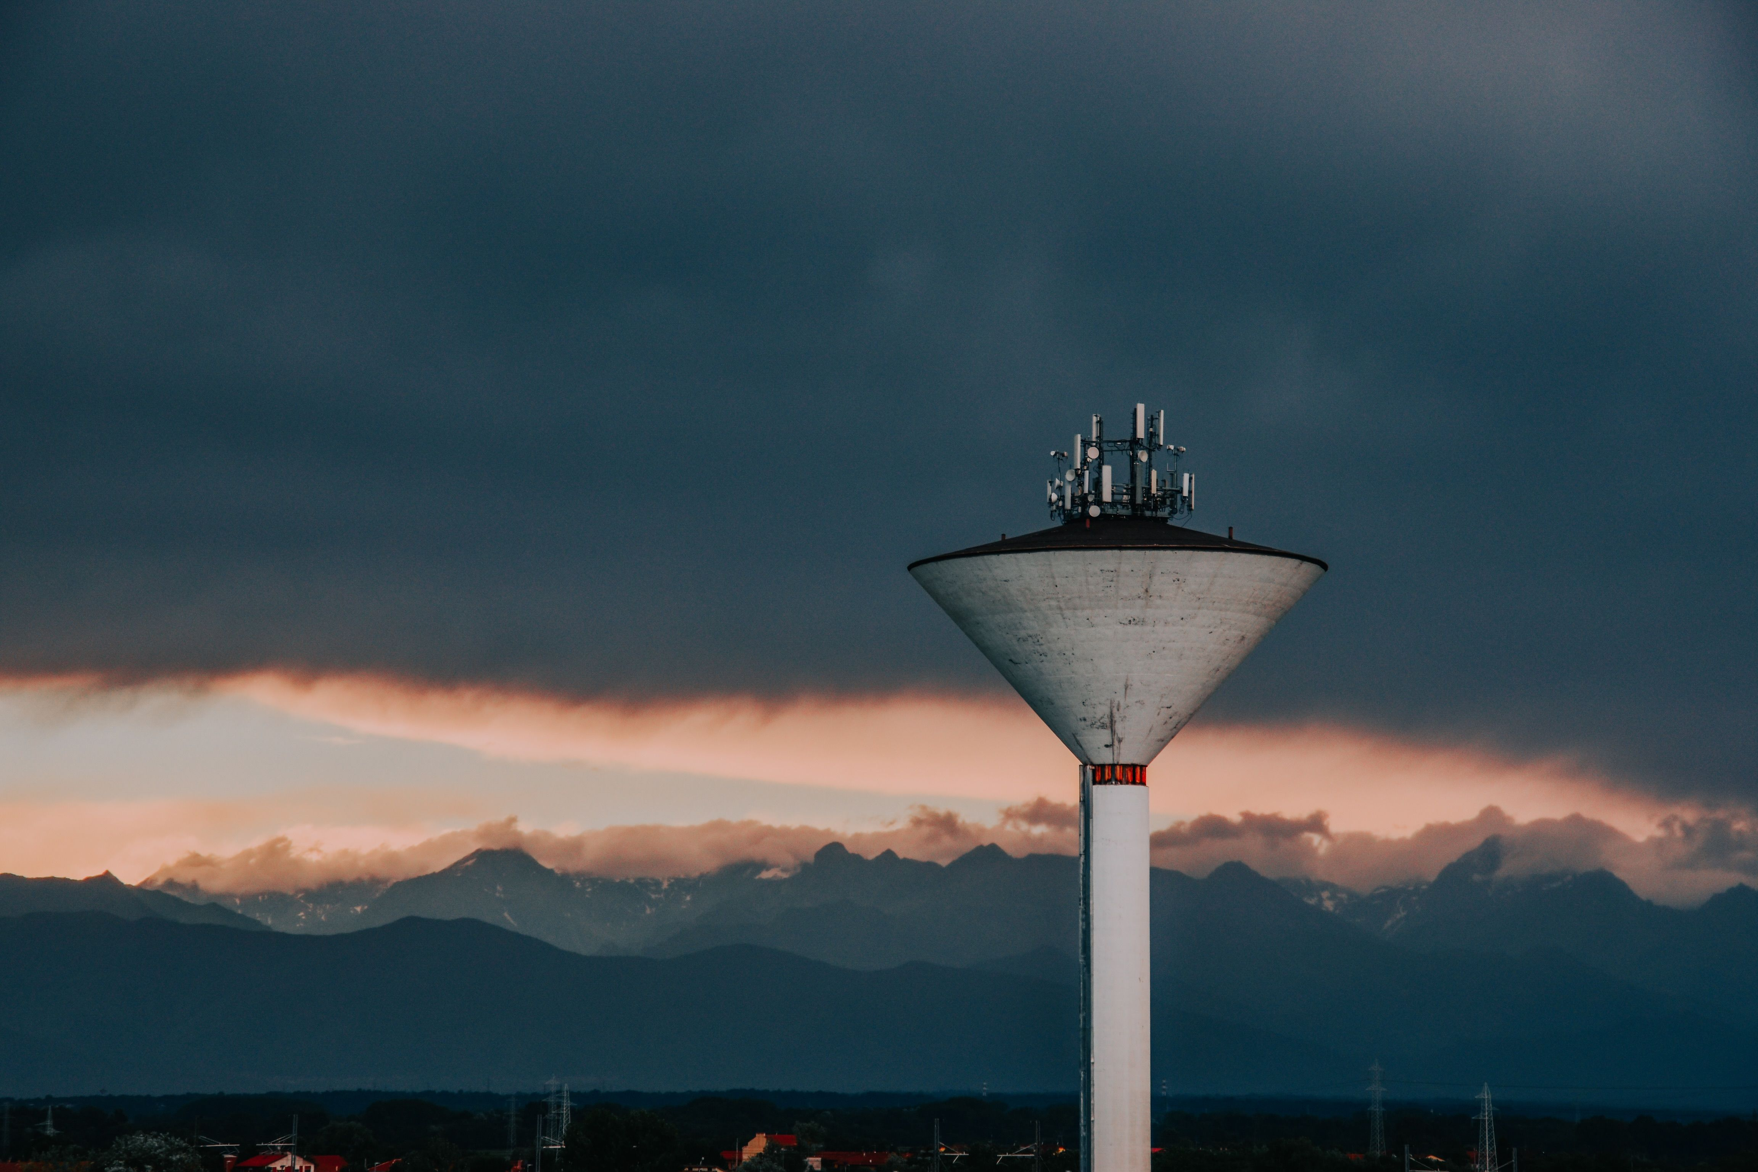
HIGH CONCEPT
After arriving at a small town in Japan, Himari, a young journalist finds the town abandoned. She starts receiving broadcast messages on her phone from the local radio tower, the only problem? It's been decommissioned for years. Who is sending these messages, and where has everyone gone?

Slide 3
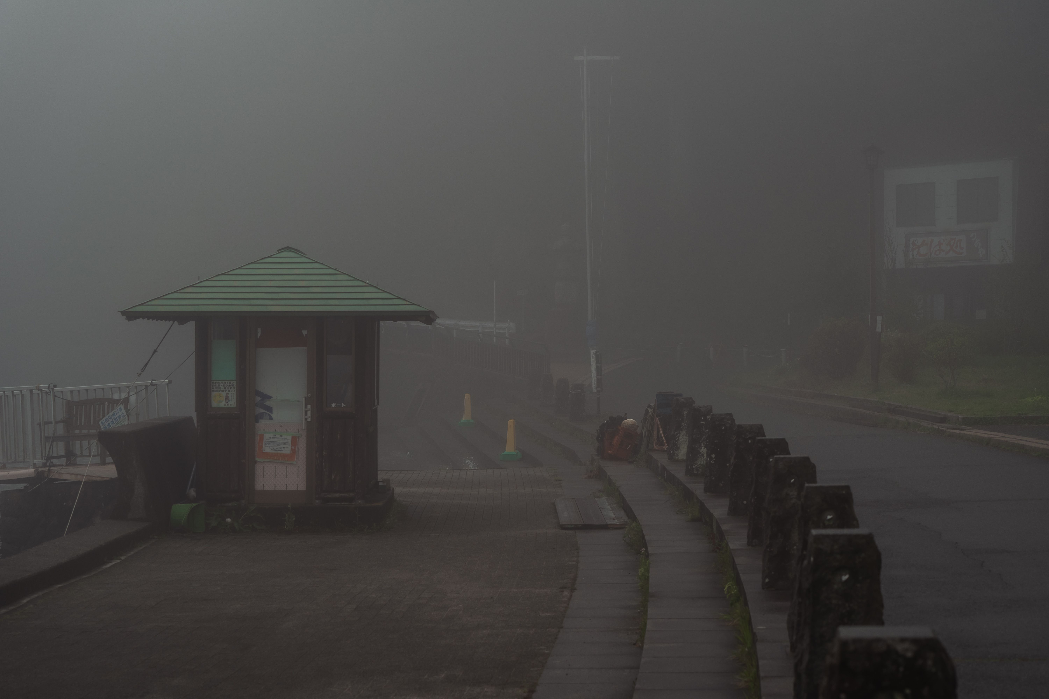
Primary Genre –
The Radio Tower is a psychological horror game focusing on the inner depths of childhood trauma and negligence.
Subgenre –
Despite being narrative driven the game also features puzzle-solving and survival mechanics.
Core Player Experience –
When players are exploring the games environments, they will be feeling isolated, tense and vulnerable whilst still gaining satisfaction from solving brainteasers.
Game-Defining Gameplay –
The player will explore locations whilst solving puzzles, encountering enemies and uncovering the overall narrative.

Slide 4
Primary Genre –
The Radio Tower is a psychological horror game focusing on the inner depths of childhood trauma and negligence.
Subgenre –
Despite being narrative driven the game also features puzzle-solving and survival mechanics.
Core Player Experience –
When players are exploring the games environments, they will be feeling isolated, tense and vulnerable whilst still gaining satisfaction from solving brainteasers.
Game-Defining Gameplay –
The player will explore locations whilst solving puzzles, encountering enemies and uncovering the overall narrative.

Slide 5
WHAT MAKES OUR GAME DIFFERENT?
Unique Mechanics
Distinctive Concept
Presentation &
Atmosphere
-
-
-
During gameplay, the protagonist will
receive radio messages on their phone
which will help the player navigate
through areas, solve puzzles and piece
together information for the overarching
narrative.
What makes this a USP? The
/

